Slide 1
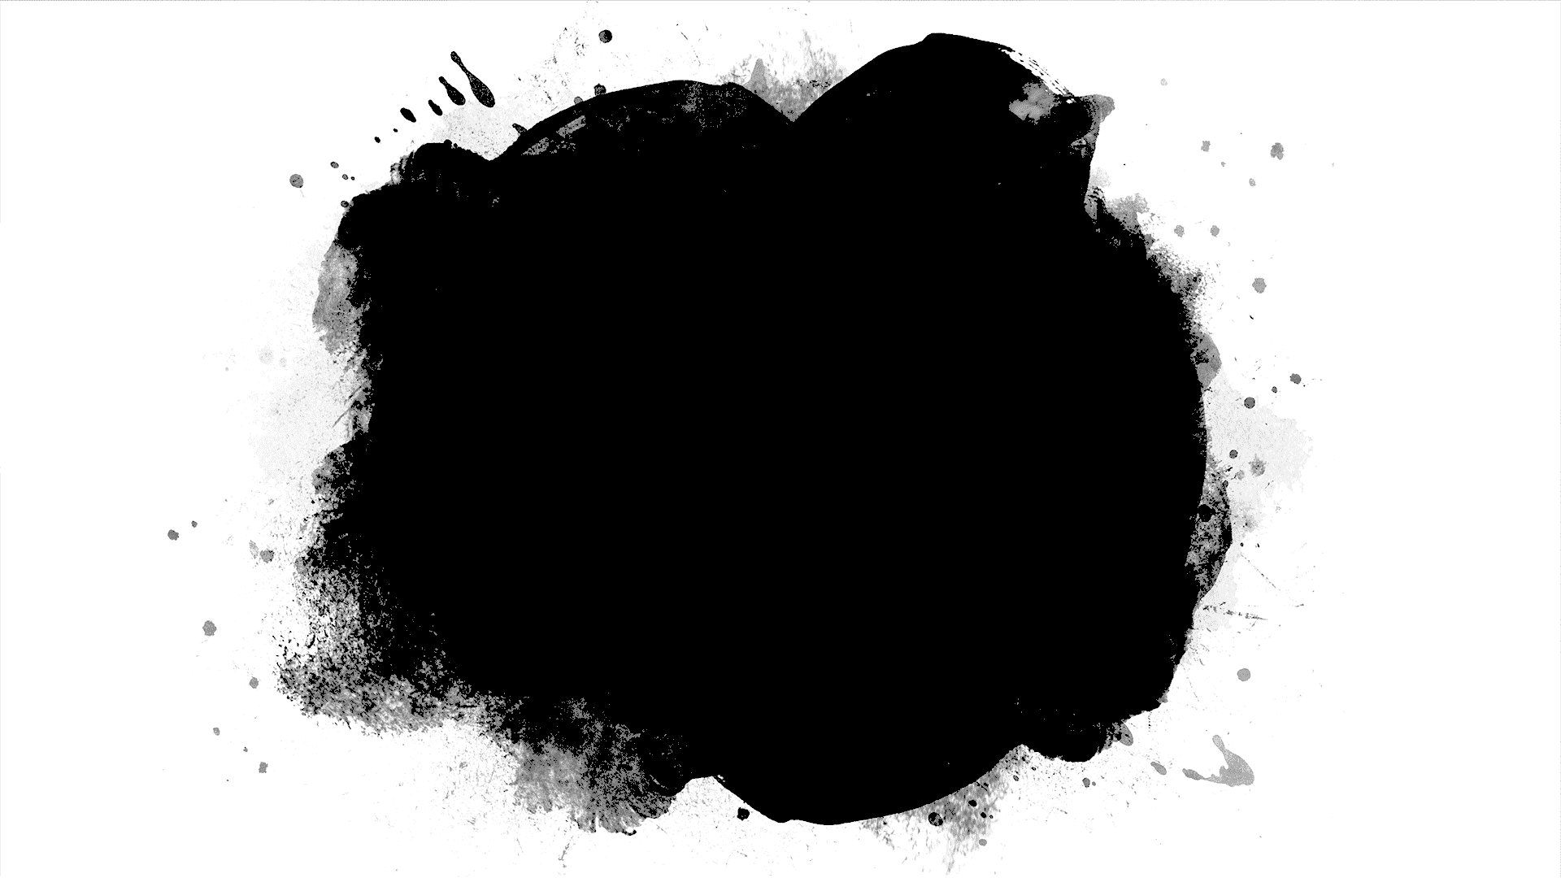
DriverPass System Analysis
Gabriel San Miguel

Slide 2
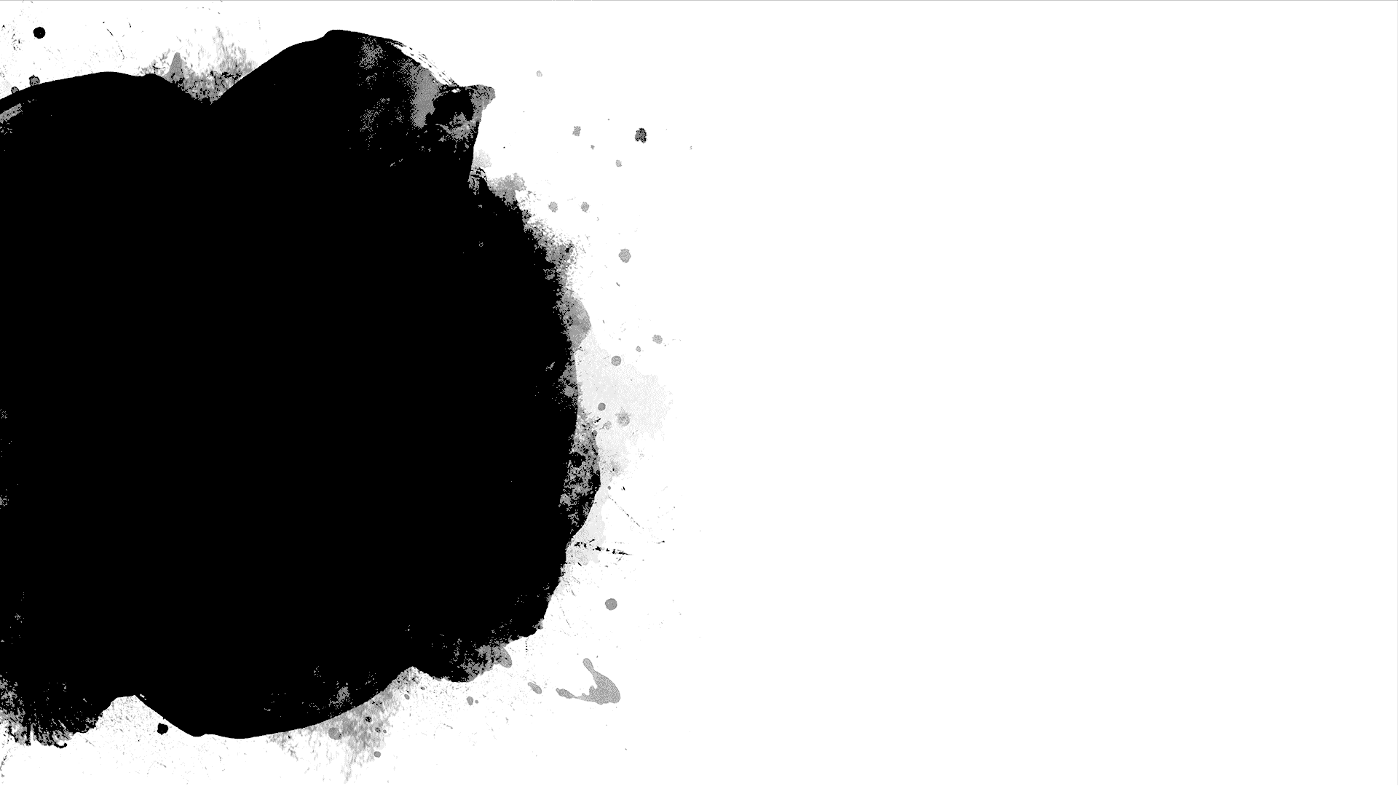
System Requirements
The system shall login users when users input the correct login information
The system shall be tailor to the DMVs rules and policies.
Users shall have the ability to modify any reservations they have made in the system.
Users shall have the ability to reset and change any information and passwords to their account.
Notes:
The functional requirements I selected for this system are the users should login when users input their correct login information or username and password. This allows for users to be sure they can log in and only see their information. If their information gets out there would not be a system breach but a user breach in this case we can allow the user to change password or contact an admin to do something with their account. The other system requirement is the system shall be tailored to the DMV’s rules and policies. Allowing the system to be aligned with the DMV’s rules and policies will help the users with after they are finished with their tests and get what they needed they can go to the DMV and do their test.
The non functional requirements I have included are the ability to modify any reservations. This is important for the user and all staff because they could make changes when needed. The other non functional requirement is to have the ability to reset passwords. This is important incase the user forgets or loses their password, we could send a link to reset and have them change it so they could get in the system.

Slide 3
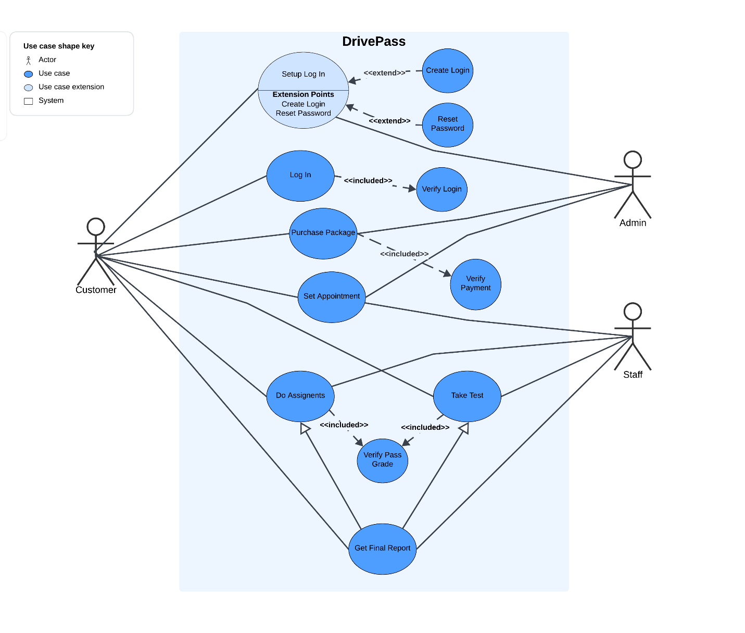
Use Case Diagram
Notes:
The different actors in my system are the customer, administrator and staff. I could have added a new customer or returning customer as actors in the system and then have them point to different use cases and some of the same use cases. The different use cases in my system are, Log In, Purchase Package, Set Appointment, Do Assignments, Take Test and Get Final Report. I even added a Use Case Extension in the beginning called Setup Log In. The customer actor points to every use case in the system, this is because the customer is the main actor. They will be functioning the system the most. My secondary actors are admin and staff, the admin points at the Setup Log In, Purchase Package and Set Appointment use cases, this is because the admin will have the functionality to change the logins, packages and appointments in the system. The staff actor will include the secretary and instructors of the system. The staff point at the use cases Set Appointment, Do Assignments, Take Test and Get Final Report. The staff will need to be able to access all appointments, assignments, tests and the final reports for all customers or students.
I kept my diagram simple and to the point, this leaves for any adaptation that needs to be made or is requested by any user, admin or staff member. The diagram follows every need that DrivePass ask for, the user is able to login and see packages, order them and set appointments. The user also has assignments and tests to do before getting their report to take to the DMV. The Admin whether it be the IT admin or the owner is in control of the login information, the packages and the appointments. The staff is in charge of the appointments and all user assignments or tests.

Slide 4
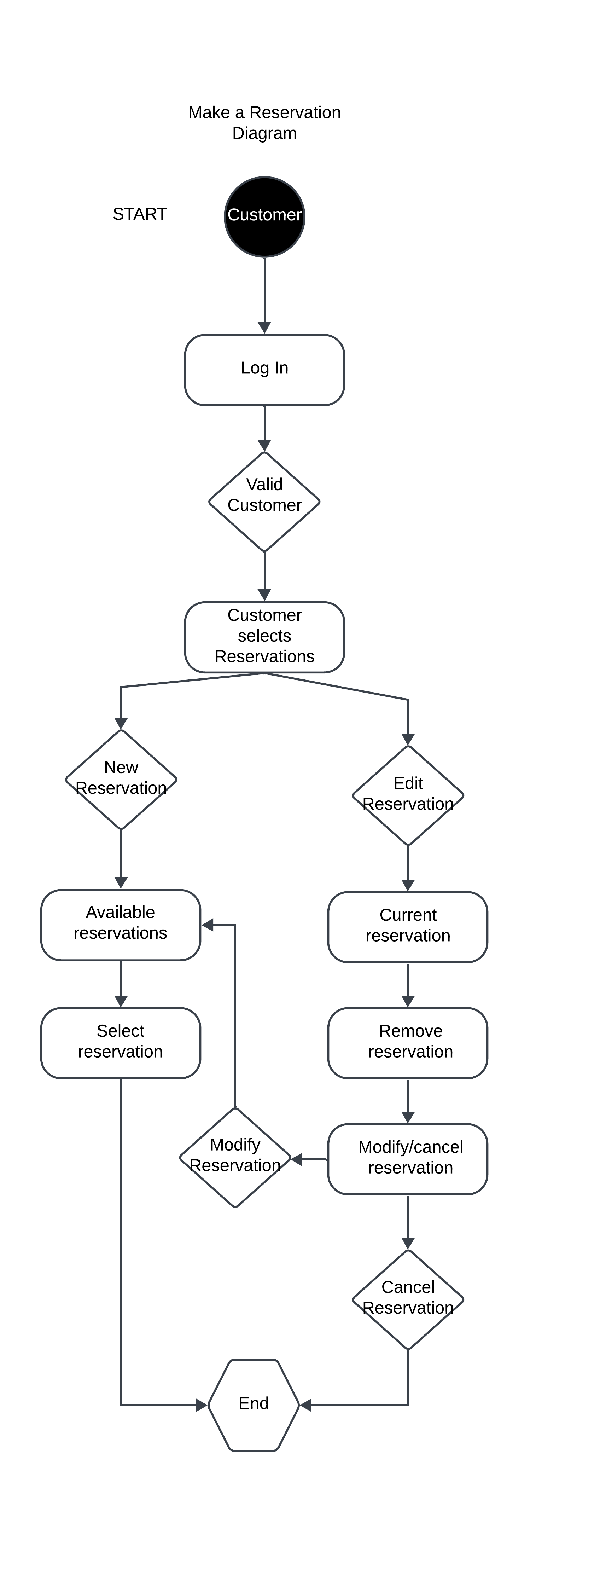
Activity Diagram
Notes:
This diagram is a “Make a Reservation” diagram, this diagram is not only showing how a user will make a reservation but edit one as well. First the user logs in, the system validates that user to be sure the user is in the system. The user will select Reservations on the user interface and will either select “New Reservation” or “Edit Reservation”. The “New Reservation” path is simple, the user will be shown available reservations and will be selecting a reservation that is available. For “Edit Reservations”, the user will be shown current reservations and will remove the reservation when selected. Then will be given a choice of either modify or cancel the reservation. If “Modify” is selected the user will go down the same steps for “New Reservation” and if “Cancel” is chosen the system will cancel the reservation and end.

Slide 5
Security
User is required to login
System validates user
If system validates user, a request to reset password is made.
After reset is made, user has to log in again and make sure they can log into the system.
Notes:
The security feature I have added is a pretty common system, users will forget the passwords of course but lets say someone found a users username. The system will verify the users information before trying to reset the password. Once the password is reset the user will have to log in again and the system will again verify the correct information is inputted before letting the user into the system.

Slide 6
System Limitations
Having to many users logged into the system.
Information storage on system
Cloud connectivity to someone who is further than a local user.
Notes:
One of the limitations that the system could have is having to many users logged into the system. Over loading the system could slow down any user logged in or a user trying to log in. This could effect new users from coming and creating an account as well. Information storage was not talked about, I think coming up with a plan to clear information after a certain amount of time will clear storage for new information coming in. Cloud servers usually have a low bandwidth already so if anyone not local wants to use the system it may be tougher for them to use the system.

